Slide 1
Course : MOBI8001 – Mobile Technology and Cloud Computing
Cloud Computing
Session 02
D5727- Dr. Eng. Nico Surantha, ST., MT.

Slide 2
Reference
[1] DE, Debashis. Mobile cloud computing:architectures, algorithms and applications. CRC Press, 2016.
[2] R. Buyya, J. Broberg, and A. M. Goscinski, Cloud Computing: Principles and Paradigms, John Wiley & Sons, Hoboken, NJ, 2010.
[3] B. Sosinsky, Cloud Computing Bible, John Wiley & Sons, Indianapolis, IN, 2010.

Slide 3
Outline
Introduction
Evolution of Cloud Computing
Cloud computing: What Is It Actually?
Characteristics of Cloud Computing
Related Technologies
Cloud Computing Architecture
Cloud Computing Deployment Models
Issues of Cloud Computing
Applications of Cloud Computing
Bina Nusantara University

Slide 4
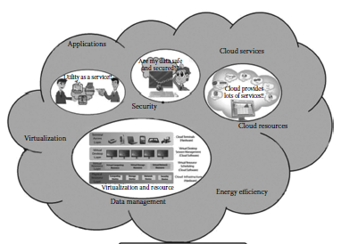
Introduction
Distributed computing paradigm
Collection of interconnected and virtualized computers, presented as unified computing resources
On-demand and pay-per-use basis
Bina Nusantara University

Slide 5
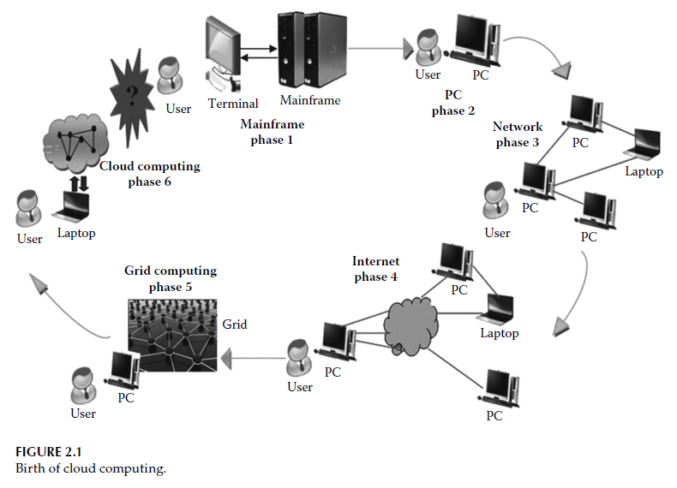
Evolution of Cloud Computing
Notes:
The shift in computing paradigm over six distinct phases ranges from simple dummy terminals
to powerful and efficient grids and clouds [4].
1. The birth of the concept of cloud computing dates back to 1950 when people used terminals to connect to powerful mainframes
simultaneously shared by many users.
2. In the next phase, almost everyone started possessing a personal computer (PC) for daily usage, and there was no need to share the mainframe
with anyone else.
3. It was during the third phase that the computer networks ushered into the
world of computing. We could work on a PC and connect to other computers via local networks
to share resources.
4. The fourth phase was the era of the Internet where local networks could connect to other local networks to establish a global network. Users started accessing remote applications and resources via the Internet.
5. Grid computing emerged during the fifth phase as an evolution. Grid computing is the collection of computer resources from multiple
locations to reach a common target. The grid can be thought to be a distributed system with
noninteractive workloads that involve a large number of files. Grids are a form of distributed
computing. PCs were used to access a grid of computers in a transparent manner.
6. With the gradual advancement in the world of computing, the sixth phase witnessed the
exploitation of available resources on the Internet in a simple and scalable way. This came
to be known to us as “cloud computing.” Cloud computing, in general, means a large number
of computers connected through a real-time communication network, typically the
Internet. A cloud provides a standard interface but hides all the available resources, hardware
and software, and services, which ideally are similar to the transparency property
of distributed systems. Our PCs are simply used as lightweight terminals having access to
the powerful Internet cloud allowing us to utilize the cloud.
But unlike the mainframe computer, which is a physical machine providing finite
computing power, cloud computing provides us with the entire power of the Internet.
Figure 2.1 depicts the evolutionary cycle or the birth of this new genre of computing, cloud
computing [4].

Slide 6
Cloud Computing: What Is It Actually?
Cloud computing is a style of computing where virtualized resources are provided to the customers as a service, which is dynamically scalable, over the Internet.
The cloud refers to the data center hardware and software that a client requests from remotely hosted applications, often in the form of data stores.
Notes:
What virtual resources?
- Computing infrastructure, application, business process

Slide 7
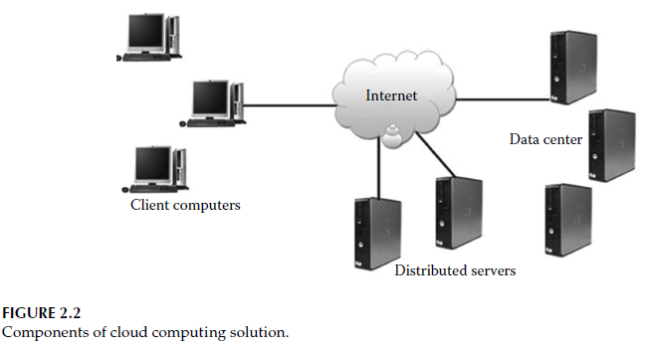
Components of Cloud Computing Solution

Slide 8
Components of Cloud Computing Solution (2)
Client: the devices used by end users
  Mobile client, e.g. PDA, smartphone
  Thin client, i.e. computers with no internal harddrives
  Thick client, i.e. reguler computer connects with web browser
Data centers: The collection of servers where the applications to which the customer is subscribe
Distributed Servers: servers present everywhere to solve the problem of site failures
Notes:
Client
Mobile client: smartphone
Thin client: computers that don’t have internal harddrives. They let the server do all the work and then display the result.
Thick client: a regular computer using a web browser such as Firefox or Internet Explorer to connect to the cloud.
Data center
Distributed servers
But these servers are not located at the same site. They
are present in geographically different locations, but this does not appear to the end users.
This cloud computing architecture solves the problem of site failure. For instance, Amazon
has its servers present all over the world. If any one site of Amazon fails, the entire system
will continue functioning efficiently as many other Amazon servers function perfectly
across the globe. The concept of distributed servers is the backbone behind the success of
the cloud computing system.

Slide 9
Virtualization as a Component of Cloud Computing
virtualization can be defined as the creation of a virtual version of a hardware platform, operating system, a storage device, or network resources.
VMware provides us with the platform to implement the concept of virtualization.
Using server virtualization, multiple Oss can run on a single physical server as virtual machines, each with access to the original server’s computing resources.
Notes:
According to experts, the architectures of today’s servers allow only a single operating
system to run on them at a time. Using server virtualization, multiple OSs
can run on a single physical server as virtual machines, each with access to the original
server’s computing resources.

Slide 10
Characteristics of Virtualized Environments
The three major components of virtualized environment:
  Guest represents the system component that interacts with the virtualization layer
  Host represents the original environment that serves the guest.
  Virtualization layer is responsible for recreating the same or a different environment where the guest will operate.
The common characteristic of all these different implementations is that the virtual environment is created by means of a software program.

Slide 11
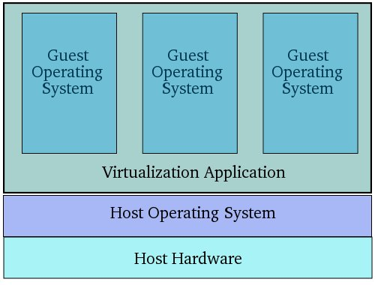
Characteristics of Virtualized Environments

Slide 12
Taxonomy of Virtualization Techniques
Machine reference model
Execution virtualization
Hardware-level virtualization
Hypervisors
Programming language-level virtualization
Application-level virtualization
Storage virtualization
Network virtualization
Desktop virtualization

Slide 13
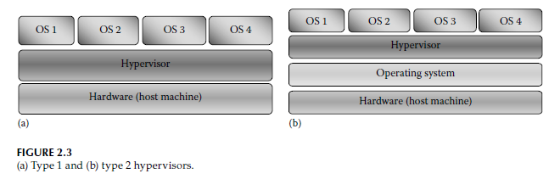
Hypervisors
hypervisor a computer software, firmware, or hardware to create and run virtual machines.
There 2 categories: type 1 (native/bare metal), type 2 (hosted)
Notes:
Hardware virtualization
There are 2 categories or hypervisors
Type 1 hypervisors are installed directly on the hardware of the host machine on which various OSs
can be installed, such as Windows, Linux, and Unix. Hence, a guest OS runs on
another level above the hypervisor
Type 2 hypervisors run within a conventional OS environment. An OS is installed on the hardware of the host machine
on which the type 2 hypervisor should be installed.

Slide 14
Hypervisors
Type 1 ex:
  Hyper-v, vSPhere
Type 2 ex:
  Microsoft Virtual PC/Microsoft Virtual Server
  VMWare Workstation, VirtualBox
Notes:
Hardware virtualization
There are 2 categories or hypervisors
Type 1 hypervisors are installed directly on the hardware of the host machine on which various OSs
can be installed, such as Windows, Linux, and Unix. Hence, a guest OS runs on
another level above the hypervisor
Type 2 hypervisors run within a conventional OS environment. An OS is installed on the hardware of the host machine
on which the type 2 hypervisor should be installed.

Slide 15
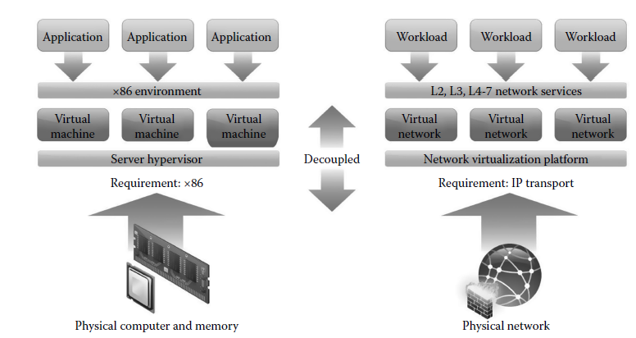
Network Virtualization
example: virtual LAN, virtual IP, and VPN
Notes:
Network virtualization is a set of technologies that hides the
true complexity of the network and separates it into manageable parts
With network virtualization, multiple networks can be combined
into a single network, or a single network can be logically separated into multiple
parts.

Slide 16
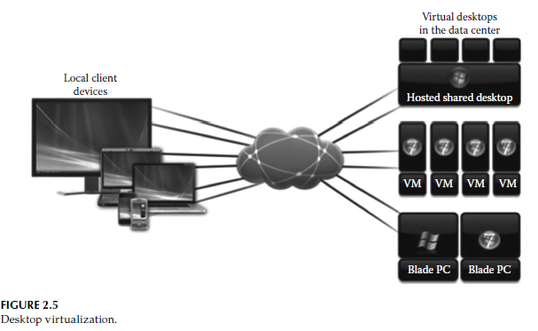
Desktop Virtualization
The OS and applications are running on server
Users can access through low cost thin-client

Slide 17
Virtualization & Cloud Computing
Cloud computing is possible without virtualization.
Virtualization and cloud computing are interrelated because the major hypervisor vendors such as VMware, Microsoft, and Citrix Systems highlight the concept of cloud.
Virtualization is about the technology, while cloud computing is about a service.

Slide 18
Characteristics of Cloud Computing
Broad network access: capabilities are accessed over the network by thin/thick client platforms.
On-demand self-service: can provision computing capabilities every time needed.
Sign up your self, receive service yourself
Resource pooling: Computing resources are pooled to serve multiple users based on a multi-tenant model.

Slide 19
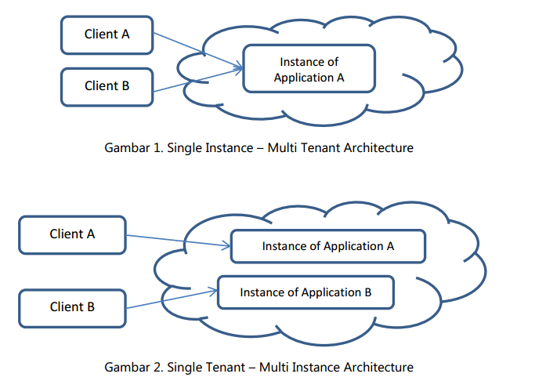
Characteristics of Cloud Computing (2)

Slide 20
Characteristics of Cloud Computing (3)
Rapid scalability and elasticity: users can purchase capabilities at any time in any amount.
Measured service: Resource usage can be observed, controlled, and reported by offering transparency with respect to both users and service providers.
“ Pay as you go”
Pay the service: in hour, per giga bytes, per
users

Slide 21
Related Technologies
Grid Computing: a distributed computing system.
Utility Computing: On-demand resource provisioning and resource usage–based billing.
Autonomic Computing: self-managing computing systems to overcome the management complexity of existing computer systems.
Virtualization: a technology that offers virtualized resources for high-level applications by abstracting the details of physical hardware.
Notes:
In a computational grid, one large job is divided into many small portions and executed on multiple machines. This characteristic is fundamental to a grid; not so in a cloud.

Slide 22
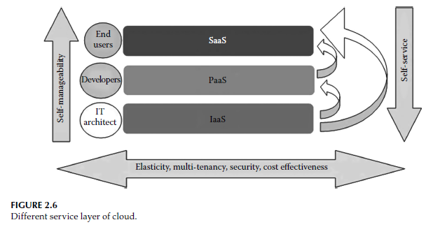
Cloud Computing Architecture

Slide 23
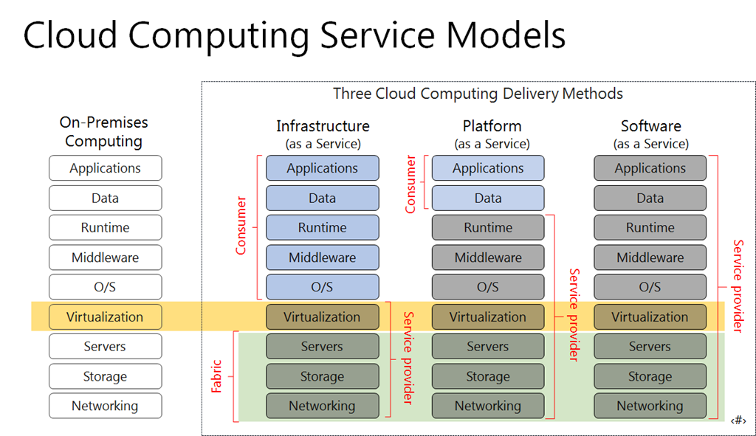
Cloud Computing Architecture

Slide 24
Software as a Service (SaaS)
SaaS is implemented to provide application- and process-oriented services to users, which are implemented into the cloud and hosted in an infrastructural view of the cloud.
SaaS provides domain-specific service to registered users for using applications into cloud as a service over the Internet.
users can take these services on a pay-per usage basis

Slide 25
Platform as a Service (PaaS)
A service model that provides all kinds of required software development life cycle model such as design tools, development tools, debugging tools, testing tools, and deployment tools.
The main consumers of a PaaS are testers, designers, debuggers as well as software developers.

Slide 26
Infrastructure as a Service (IaaS)
It gives users infrastructure support (i.e., compute, storage, OS, networking) as a service.
The key characteristics of an IaaS cloud are scalability and elasticity, enabling computing resources to level up and down.
An IaaS is also referred to as Rcloud.
It can be further separated into 3 categories, i.e:
  Computing as a service
  Storage as a service
  Database as a service

Slide 27
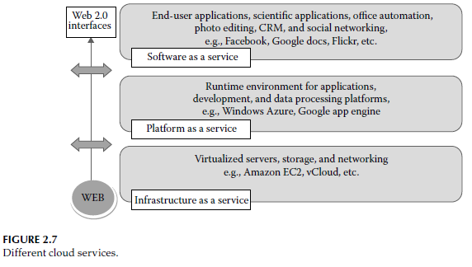
Different Cloud Services

Slide 28
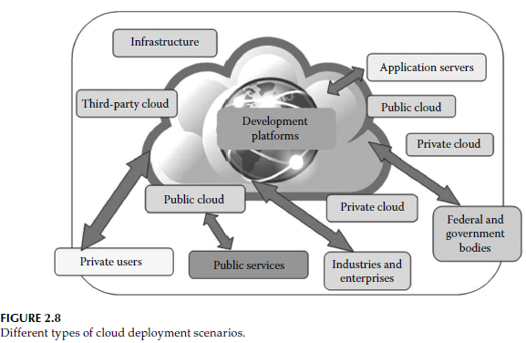
Cloud Computing Deployment Models
A cloud environment can be deployed using the following three main models:
  Public cloud
  Private cloud
  Hybrid cloud

Slide 29
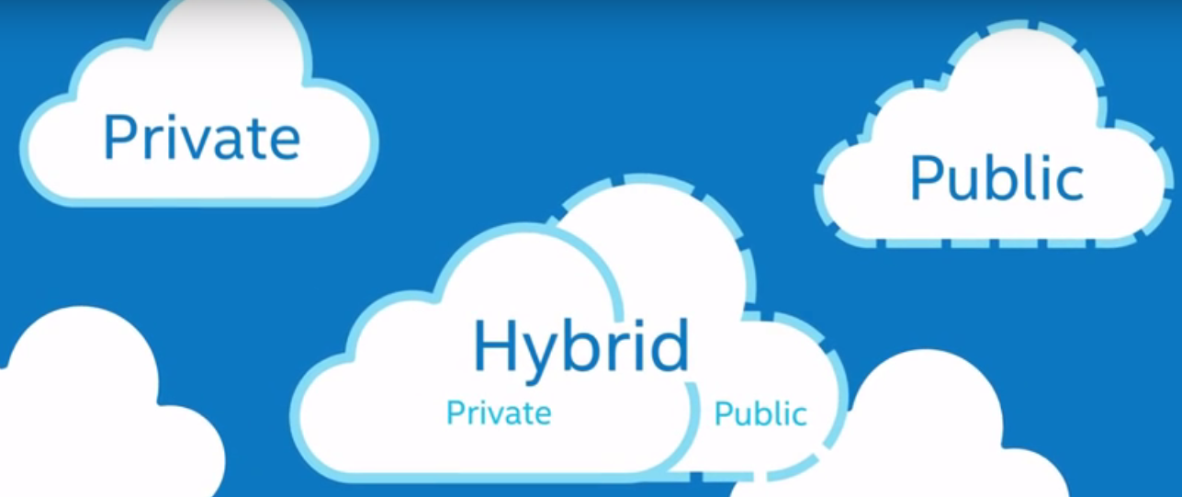
Cloud Computing Deployment Models

Slide 30
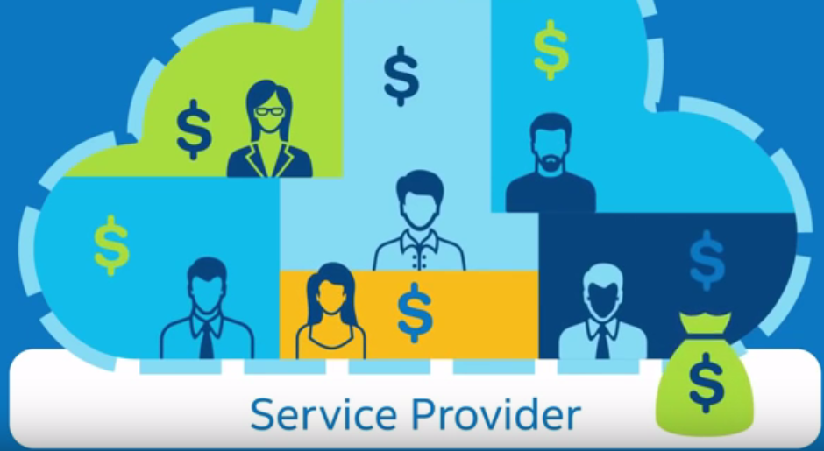
Public Cloud
Organized by service provider
Multitenant
Pay-as-you-go

Slide 31
Public Cloud
It is shared and used by customers via the internet, e.g. Amazon Web Services (AWS)
The benefits:
  Very low-cost
  Storage efficiency and computational services
  Easy to connect to servers
  customers only pay for the services they need.
  Widely spread availability irrespective of geological area.
Disadvantages:
  Variety of applications incompatibility, e.g. Microsoft-Amazon incompatibility
  Security issues

Slide 32
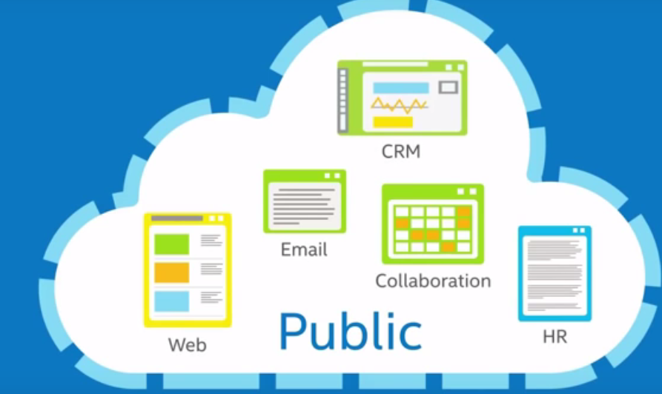
Public Cloud

Slide 33
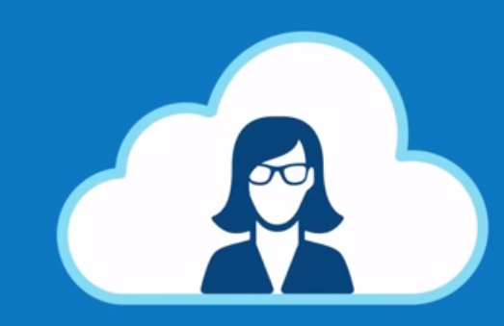
Private Cloud
Organized by yourself
Single tenant

Slide 34
Private Cloud
It is a network of all services or a data center that stores hosted services for a restricted number of people.
When public cloud resources are used by a service provider to create a private cloud, it is called a virtual private cloud.

Slide 35
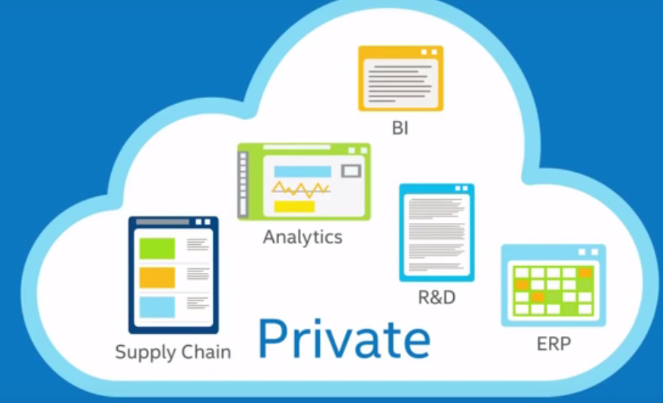
Private Cloud

Slide 36
Hybrid Cloud
Sometimes, it may happen that private clouds run out of capacity. Therefore, hybrid cloud is introduced.
It is an integration of two or more clouds that remain distinctive entities but are bound together.

Slide 37
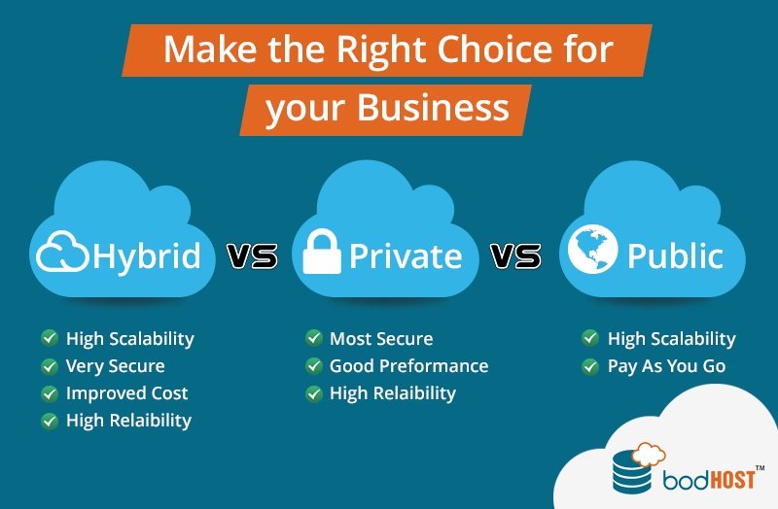
Hybrid Cloud

Slide 38
Public vs Private Cloud
Service-level agreements are required for reliability and real-time performance.
Security and privacy of valuable data are huge issues.
Cost savings of shared model achieved.
Prospective for vendor lock-in.

Slide 39
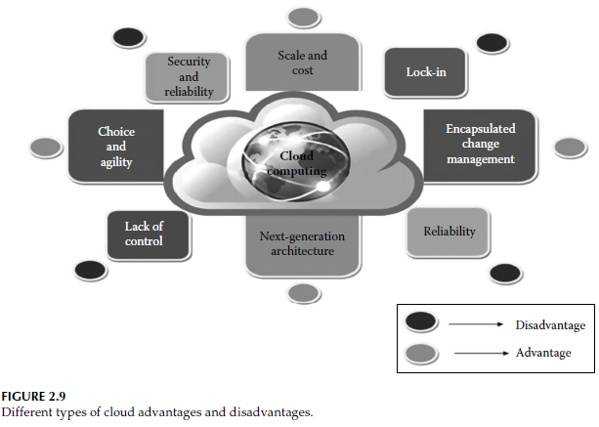
Cloud Advantages & Disadvantages

Slide 40
Issues of Cloud Computing
Scheduling
Security and Trust
Energy Efficiency
Interactivity, Real Time Streaming
Data management
Quality of Service
Resource Utlilization

Slide 41
Scheduling
The main aim of a job-scheduling algorithm is to improve the performance and quality of service and, at the same time, maintain the efficiency and fairness among jobs as well as reduce the execution cost.
Job-scheduling algorithms can be categorized into two main classes:
  Batch-mode heuristic algorithms: jobs are collected when they arrive in the system. The scheduling algorithm starts working after a fixed amount of time, such as a Round Robin algorithm.
  Online-mode heuristic algorithms: jobs are scheduled individually as soon as they arrive in the system. They are more suitable for a cloud environment because of the cloud environment’s heterogeneity and varying processor speed, such as the Most Fit Task scheduling algorithm.

Slide 42
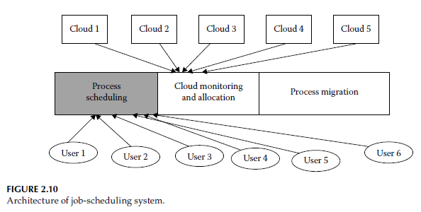
Architecture of Job-Scheduling System
Figure 2.10 shows the middle layer architecture of a job-scheduling system, which performs cloud allocation in the case of underload and overload conditions.

Slide 43
Security and Trust
Storing personal information inside the cloud requires high security to protect it from hackers.
Still many people are unwilling to use offloading for fear of losing their confidential information.
For secured communication, AAA (Authentication-Authorization-Accounting) is used and for data security, various encryption techniques are available, such as AES, DES3, and Two-fish.
Trust is the firm belief in the reliability of others, that they will behave or work as we want.

Slide 44
Types of Trust
Direct trust: If one entity trusts another entity through direct association or communication.
Indirect trust:
  If two entities are not directly associated to one another and know each other through a third entity, then this type of trust is called indirect trust.
  The trust value will be calculated based on observation and recommendation.
Hybrid trust:In the case of hybrid cloud, the users get combined services of both the private and public cloud.

Slide 45
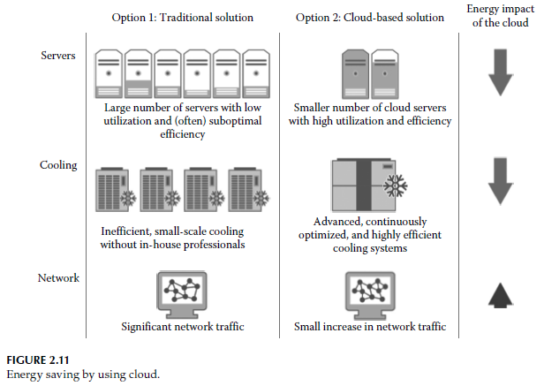
Energy Efficiency Issue

Slide 46
Energy Efficiency Issue (2)
Reduction in Direct Energy: A cloud-based solution makes it possible to reduce energy consumption by aggregating the demand of global users. In this case, only those servers can be utilized properly.
Reduction in Energy for Cooling Server
Increase in Energy Consumption for Increase in Network Traffic: We can ignore this additional energy consumption because the aforementioned two points keep the cloud-based result a bit ahead of the traditional solution.

Slide 47
Interactivity, Real-Time Streaming
Cloud computing gives a new approach in which the required bandwidth is supplemented to the cloud nodes for real-time communication.
This implies that a specific user might be served media from different sources.
Multipath RTP (real-time transport protocol) can be used to optimize transmission.

Slide 48
Data Management
The major issue of cloud computing is providing security to users who store their data on the cloud. The privacy policies should be maintained by the cloud-hosting company.
Data storage and Access on Cloud
  Public cloud storage, e.g. Gdrive, Dropbox, etc
  Private cloud storage
Data Portability and Interoperability:
  Interoperability gives cloud users the freedom to switch from one cloud service provider to another as their needs for computation may grow or shrink from time to time, and as a result, migration is needed to take place to cut the cost.

Slide 49
Quality of Service
QoS is the most important topic in a distributed system and is often regarded as the resource reservation technique to achieve a certain level of performance and availability of services.
Simply QoS provides priorities to different applications to guarantee the expected level of performance.
The required QoS can be achieved by managing packet loss, delay, delay jitter, and bandwidth parameters on a network.
Dell provides software, Scrutinizer NetFlow Traffic Analyzer, which quickly pinpoints the source of jitter, packet loss, latency, or a misconfigured network, visualizes real-time or archived application traffic data, and analyzes traffic in high-throughput environments.

Slide 50
Resource Utilization
About how to make both local and global resources available to users in an efficient and effective manner and this process is done in the following ways:
  Data migration: data are brought and computed to the location of computation through the network, and after the computation, the resultant sets of data are brought back to the original location from where the data had come.
  Computation migration: In computation migration, part of the current thread is moved to the processor where the data reside. At the remote processor, the thread portion executes on the data, which are also in the cloud or in remote storage. This, in turn, makes subsequent access in the thread portion local.
  Distributed scheduling: In this technique, processes are migrated from one location to another. When the first machine or processor where the process originated is overloaded or it does not have necessary resources to execute that process, the process is transferred to another location for execution.

Slide 51
Applications of Cloud Computing
Mobile Cloud Computing
Healthcare
Cloud Gaming
Storage

Slide 52
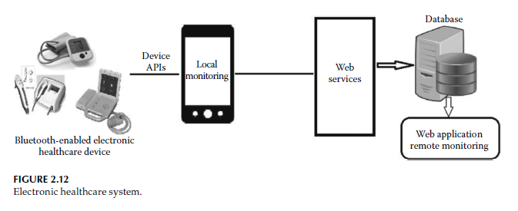
Electronic Healthcare System

Slide 53
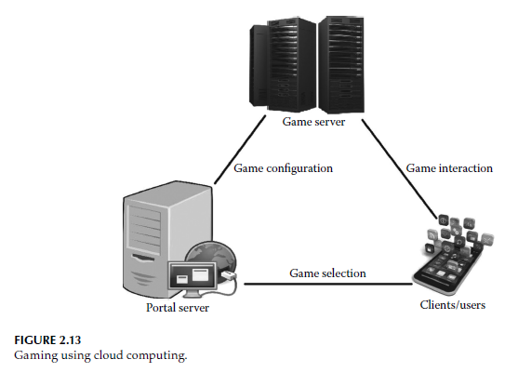
Cloud Gaming

Slide 54
Conclusion
Cloud computing has brought a revolution in the field of computation.
Cloud is a cluster of computers with a virtually huge storage capacity, unlimited resources, and processing ability.
Cloud computing is related to utility computing where services are provided as utility to users who use them on a pay-per-use basis.
In this chapter, we have discussed the evolution, architecture, and applications of cloud computing. A case study of creating a cloud environment is also described in this chapter.

